Slide 1
Hilbert R - Trees

Slide 2
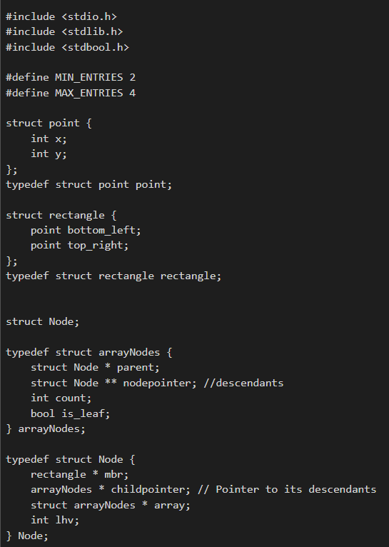
Structures
Point - Represents a point in a 2 dimensional plane using variables x and y (decimal values)
Rectangle - Spatially defines a rectangle by specifying it’s top right and bottom left corners.
Node - Represents a singular entity of a Hilbert R-Tree which contains the minimum bounding rectangle, largest hilbert value of the rectangle, and a pointer to the array it is in and a pointer to the array of children nodes under it.
arrayNodes - Represents an array of node structures and also contains a pointer to the parent node of the array, as well as 2 variables, count (integer) to keep a track of how many nodes are in the array and is_leaf (boolean) for whether the array consists of leaf nodes or internal nodes.

Slide 3
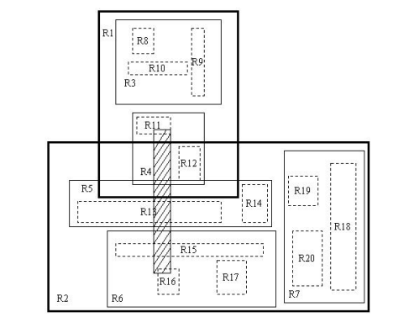
Search
The search function in Hilbert r-trees is very similar to the search function that is used in regular r-trees.
The premise is: given a hilbert r-tree T and a rectangle R, we need to find all the leaf nodes from T whose mbr values intersect the rectangle R.
We have implemented this code using 2 functions
Overlap()
search()
These exact functions are explained in the coming slides.

Slide 4
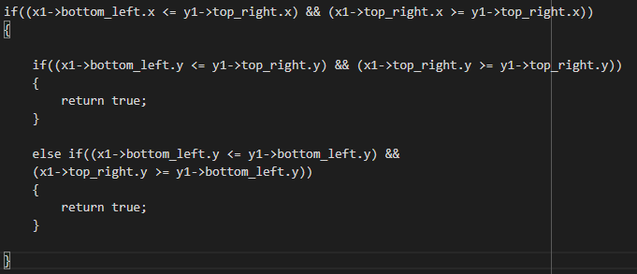
Overlap() - Search Function
The overlap function is very simple, its purpose is to check whether the two rectangles given as input overlap in any way.
The function checks if there is any overlap, and if there is, it returns a true value.
Otherwise, it returns a false value.

Slide 5
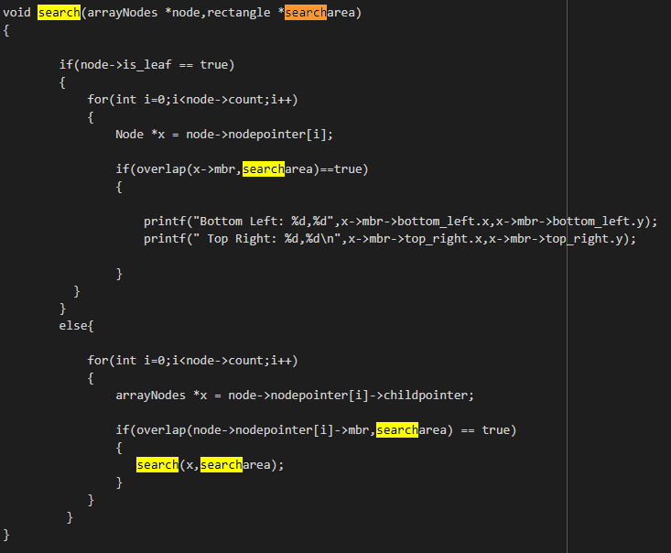
Search() - Search function
The search function is the main function used for searching.
It checks the arraynode given as inputs nodes one by one.
If a node overlaps with the area being searched:
Checks if leaf node:
If true(leaf node):
prints the value of leaf node
If false(internal node):
Starts the search operation on its children

Slide 6
Insertion
The insert function is the function that we use in order to add nodes to our Hilbert R-tree.
Here we choose the nodes based on LHV, picking the one with the minimum value.
While this may initially sound like it is an easy process, it is only done after using multiple functions in conjunction with one another. These functions used along with insert() are as follows:
chooseLeaf()
handleOverflow()
adjustTree()

Slide 7
Insert() - Insertion Function
This function is the function from which all the other related insertion functions branch off of.
The ChooseLeaf function is used in order to find the leaf where the new rectangle is to inserted.
If the leaf where the node is to be inserted into is full(has 4 entries), we invoke the HandleOverFlowNode() function in order to fit the node into its correct position.
However, if the layer is full(no leaf/sibling nodes available), we call the adjustTree function in order to create changes in the tree in order to correctly fit the new node.

Slide 8
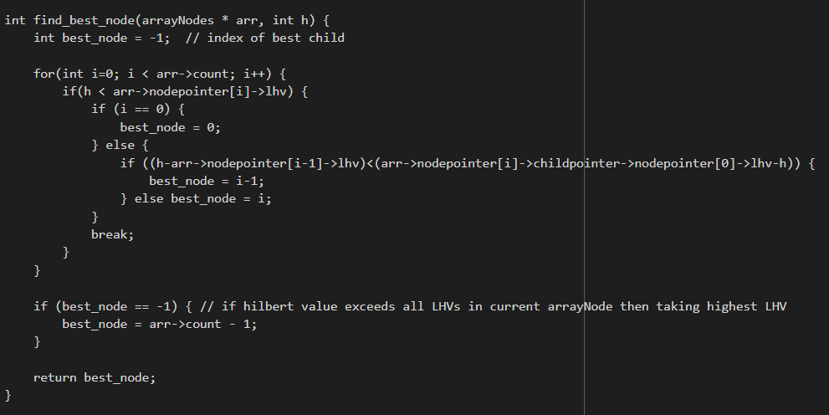
find_best_node() - insertion function
The find_best_node function takes an array node and the hilbert value of the node to be inserted as parameters to find the appropriate node under which the node to be inserted is to go.
This is done by comparing the hilbert value of the node with the LHVs of the nodes in the array and choosing the the node whos LHV is closest to this hilbert value.
If the Hilbert value of the node exceeds the LHV, the last node in the array which has the highest LHV is chosen as the appropriate node.
The function returns the index of the appropriate node in the given array of nodes.

Slide 9
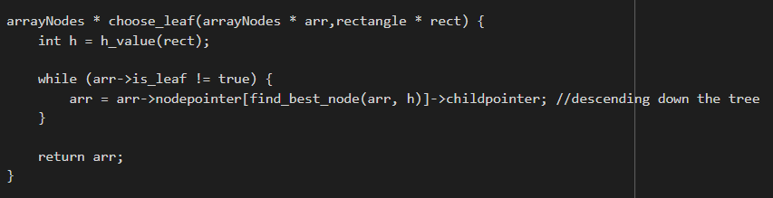
choose_leaf() - Insertion Function
The Choose Leaf function iteratively descends down the tree while making use of the find_best_node function until an array of leaf nodes arr is reached.
The array of leaf nodes is then returned.

Slide 10
handleOverflow() - Insertion Function
The case where the leaf node in question has 4 nodes exactly, meaning that we cannot add anymore values into it.
Finds the set of all rectangles at that possible level, and then divides them again.
It basically restructures all of the nodes in such a way that we are able to fit another node into the tree.
However, when the layer is full, i.e all the sibling arrayNodes are full, we need to call the adjustTree function in order to make changes and accommodate the new node.

Slide 11
HandleOverFlowNode() - Insertion Function
This function is called in the case where the leaf nodes of the tree we wish to insert the new point in is full (i.e. has 4 entries). In this function, we look at the immediate siblings of the node to see if there is space for accommodation.
If space is there, the parent node is restructured and new nodes are created to insert this point at the corresponding position.
If the immediate sibling nodes are also full, we then invoke adjustTree and pass the set of nodes to help it create a new node at the parent level.

Slide 12
AdjustTree() - Insertion Function
We first check if the arrayNode we wish to restructure is the root node.
If yes, we invoke the splitRoot() function.
If no, we split the now 17 nodes among 5 parent nodes in such a way that we ensure that each arrayNode has minimum 2 nodes. Now, we again recall HandleOverFlowNode() function with one arraynode containing the pre-existing 4 nodes and the new parent node to be included in the tree. Basically, we are doing the same thing we were doing before, just now we have gone one level up in the tree. This way the tree keeps adding new nodes till it reaches the root node.

Slide 13
SplitRoot() - Insertion Function
If we find the root node through adjusttree and we still need to add a rectangle, we call splitRoot.
This is for the edgecase where we have to add a node/rectangle to the root node and the root node is full. In this case, we create a parent node and sibling node for the current root. The 5 nodes are split among the sibling nodes and the parent node becomes the root node.

Slide 14
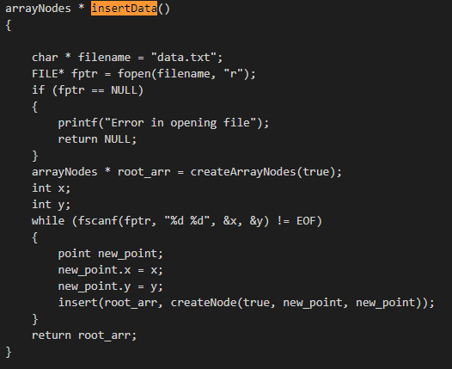
insertData() - Insertion Function
The insertData function takes data from the file line by line, creating nodes for each point and inserts them into the tree iteratively until the file ends.

Slide 15
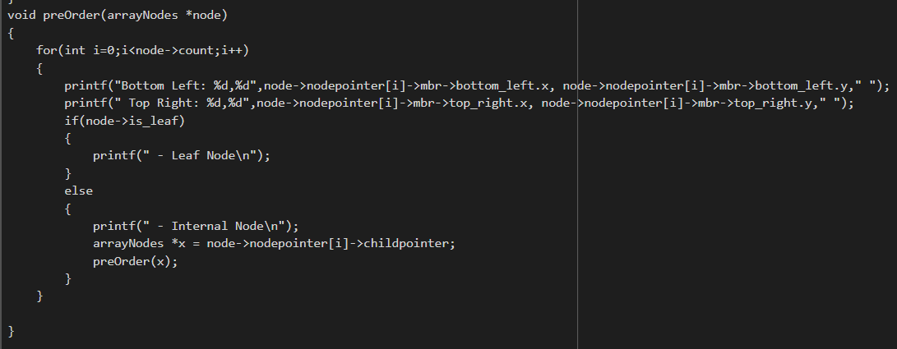
Pre-order traversal
Here, we run a loop iterating through the nodes, first printing the bottom left and top right corner of each node’s rectangle.
If the node is a leaf we print “Leaf Node” and move on, else we print “Internal Node” and recursively run the function this time passing current node’s child as function parameter.
Doing so, we traverse and print the nodes from left to right and if a node has descendants we visit all the descendants before moving onto the next node.

Slide 16
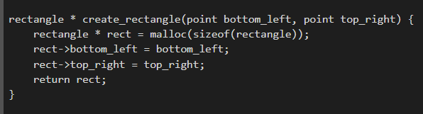
create_rectangle() - Tree Function
The function create_rectangle takes bottom left and top right corners of rectangle to be created as input parameters to define the rectangle.
We dynamically allocate memory to a rectangle pointer and define the bottom_left and top_right variables of the rectangle pointers using the input parameters.
We then return this rectangle pointer.

Slide 17
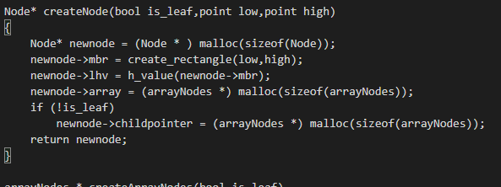
createNode() - Tree Function
In createNode we dynamically allocate memory to a node and assign the value of it’s MBR parameter using create_rectangle and passing the corner values as arguments.
We also assign the node’s hilbert value parameter using the h_value function and passing it’s MBR as an argument.
If the node being created is a leaf we assign its childpointer to be NULL since it is an external node (no descendants). If it is an internal node we dynamically allocate memory to the childpointer parameter of the node for the array of children nodes under the internal node.

Slide 18
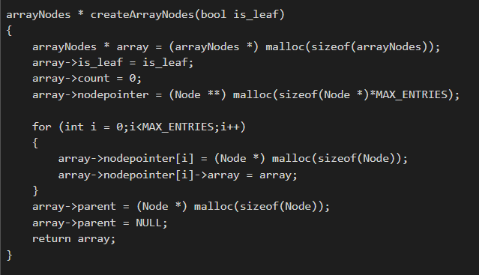
createArrayNodes() - Tree Function
In this function we first dynamically allocate memory to an arrayNodes structure. We then assign the value to it’s is_leaf parameter using the input parameter.
We set the count to zero as we have only created the array and not populated it with nodes yet.
We allocate memory to the array through the nodepointer parameter and using a for loop we iterate through all entries and dynamically allocate memory for each node in the array.

Slide 19
Helper Functions
Throughout the code, we have used a few functions in order to make the code easier to code and understand.
getSetNodes() - Takes an array of nodes and node to be inserted as parameters and creates an array of all child nodes of the array parameter and inserts the node to be inserted in the correct position in the new array when the nodes in it are sorted by LHV.
create_mbr() - Takes an array of nodes as a parameter and is used after a new node has been inserted in that array. It creates a new minimum bounding rectangle for the array based on the nodes in it and updates the rectangle stored in the parent of the array with this new MBR.

Slide 20
Thank you!
Aneesh Kabra (2021A7PS0442P)
Shyam Raghavan (2021A7PS0013P)
Agniva Banerjee (2020B3A70922P)
Vidit Benjwal (2021A7PS0004P)
Jai Bothra (2021A7PS0015P)

